Slide 1

To-Do List Web Application-Phase 2
A Simple, Smart Task Manager for Daily Productivity
Aaron Agyapong
Dlbcspjwd01, 05/05/2025
GitHub repository: Organized Harmony

Slide 2

Purpose of the Web Application
Purpose of the Web Application
This to-do list web application is designed to help boost the productivity of users. It allows you to manage tasks you want to complete by creating, updating and deleting tasks upon completion. It also provides authentication so that each users data is secure and accurate.
Create and track tasks until completion
Authentication for user identification
Edit or delete entries
Add pictures to a task to aid memory

Slide 3
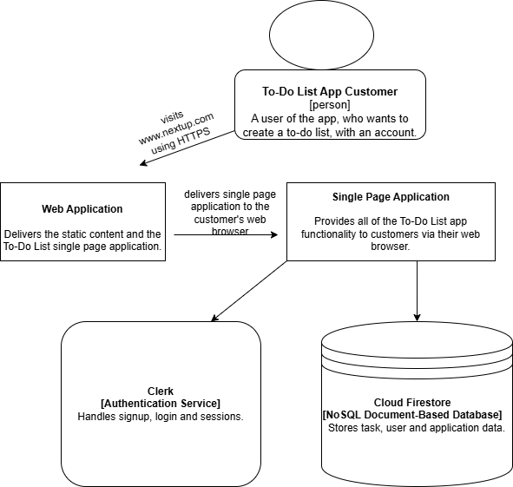
SYSTEM ARCHITECTURE

Slide 4
Technology stack overview
FRONTEND
Vite – Lightning-fast frontend tooling
Typescript – Interactivity and logic
React.js - Component-based UI
Tailwind CSS – Utility based styling
shadcn/ui – Beautifully designed components
BACKEND
Cloud Firestore – NoSQL database
Clerk – Authentication
Firebase – Hosting and file storage

Slide 5
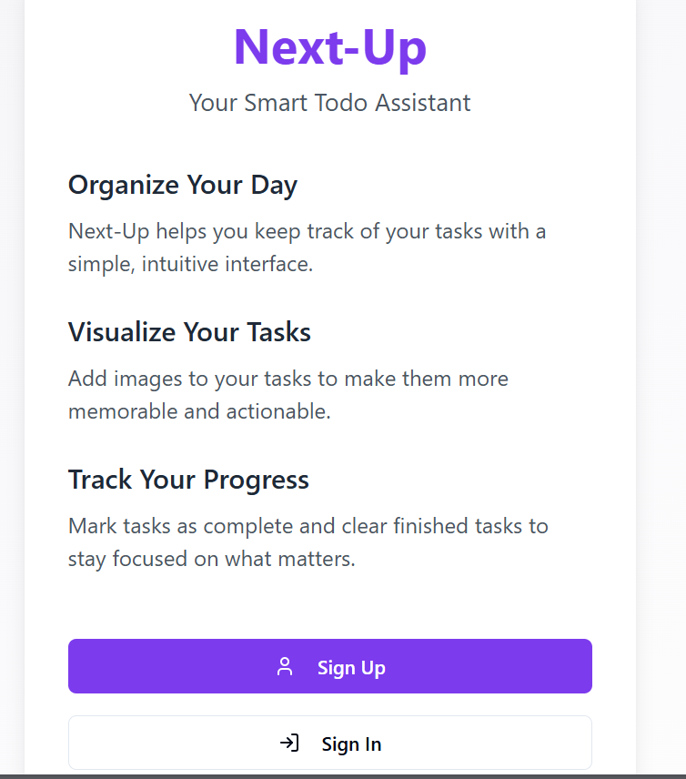
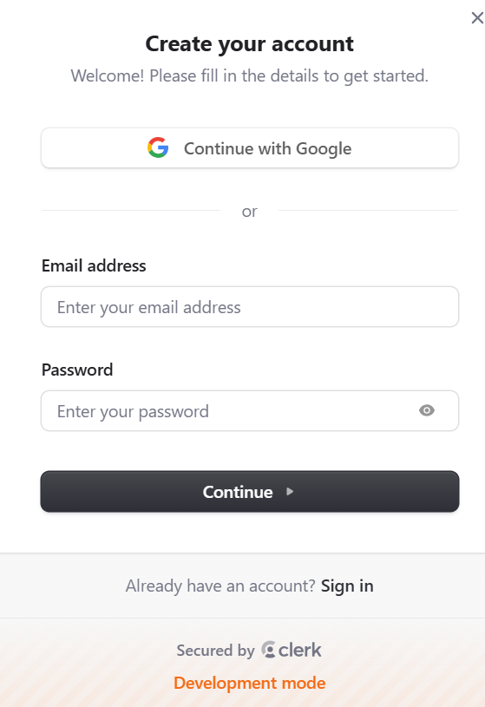
Web App Screenshots and Features
This is the initial page before signing in or signing up. You’re allowed to sign in with Google too. It also allows you to toggle the theme in case you want to switch to dark mode.

Slide 6
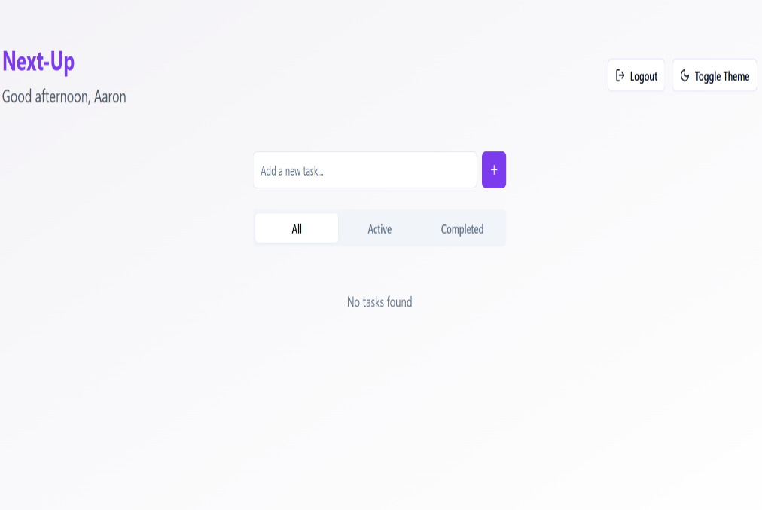
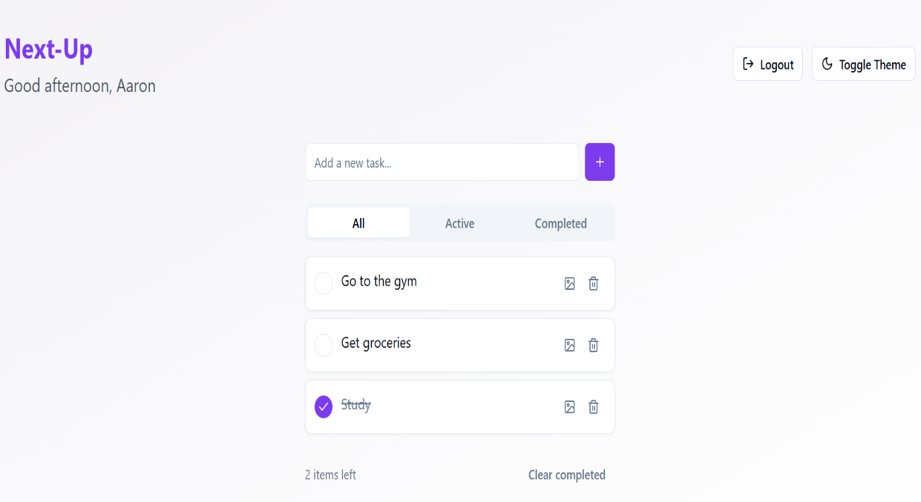
Web App Screenshots and Features
This is after you have signed in. You’re able to add tasks, attach pictures to tasks and then as seen in the picture, you can mark task as complete after you’re done.

Slide 7
Changes Made From Initial Proposal
Initial Plan
Firebase Auth
Current Implementation
Clerk
Reason for Change
Easier UI, Built-in session management
Cloud Firestore
Firebase Realtime DB
Better scalability and structure

Slide 8
